Slide 1
Pneumonia Detector
By: Carlos Lopez, Salam Othman, Mohamad Abboud

Slide 2
What is Pneumonia?
An inflammation in the air sacs in the lungs
Result of an infection caused by bacteria, viruses or fungi that are breathed into the alveoli
Pathogens could be spread through coughing, sneezing or contaminated surfaces
Best detected by chest X-rays
Positive pneumonia X-rays exhibits one or more of the following symptoms: hemidiaphragm elevation , Mediastinal shift , Rib crowding, or Bronchovascular crowding

Slide 3
The prototype mission
An X-Rays Classifier: Normal, Pneumonia
Assist doctors or medical professionals with the evaluation of chest X-rays and provide a highly accurate diagnosis on Pneumonia
A user friendly application that displays the diagnosis result when given an X-ray image
Easy upload of the X-ray image

Slide 4
The Dataset: X-ray scans
The Convolution Neural Network model is trained on a data set consisting of 5,219 pneumonia and normal chest X-ray scans.
The CNN model is also tested on 627 images of pneumonia and normal chest X-ray scans to verify accuracy using known and predicted results.

Slide 5
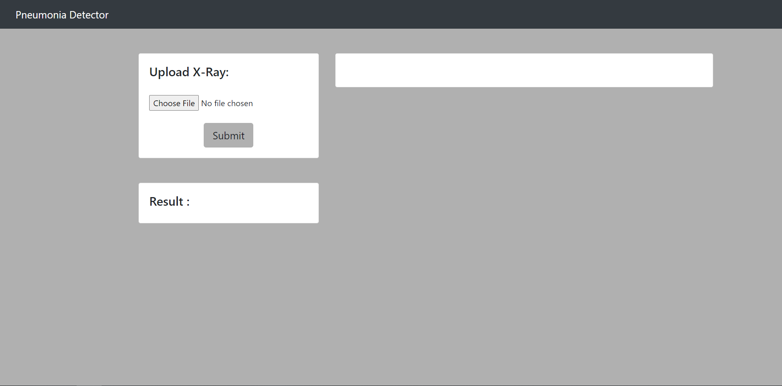
Primary purpose: Pneumonia detection
The UI is convenient and easy to use for the end users. The user simply uploads a chest X-ray image and clicks submit to retrieve the results from the CNN model.

Slide 6
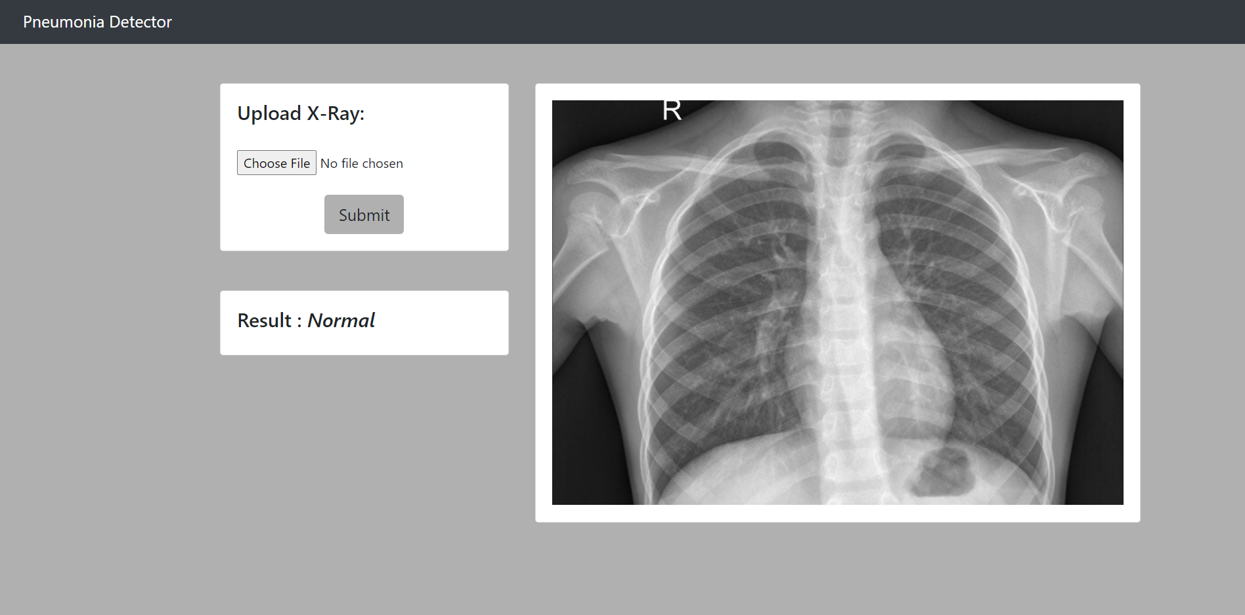
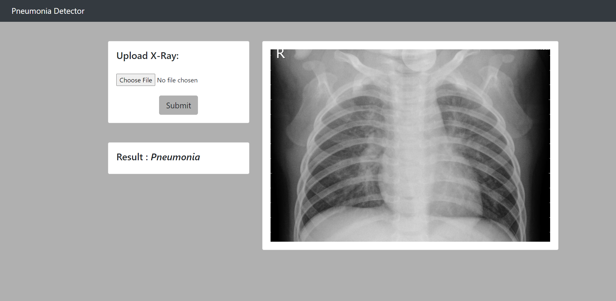
Primary purpose: Pneumonia detection
X-ray scan of normal lungs X-ray scan of lungs with pneumonia

Slide 7
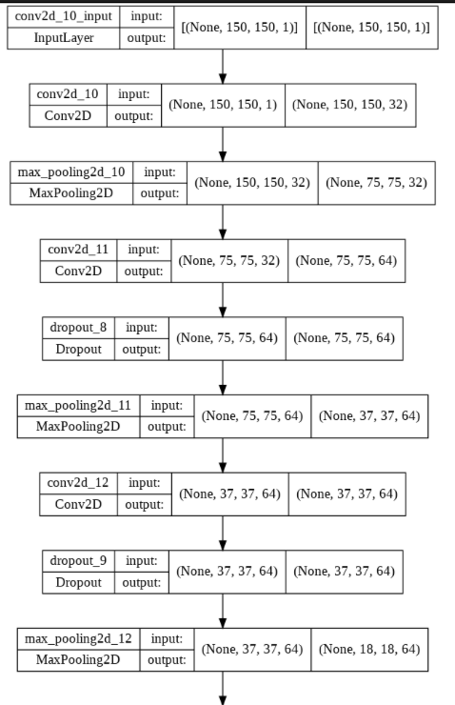
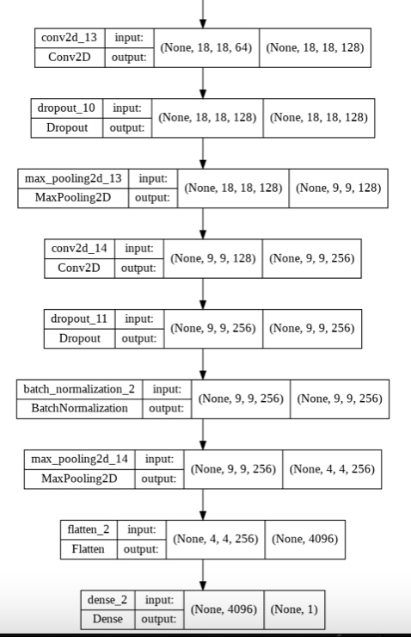
A visualization of the
Implementation of the
CNN Model.

Slide 8
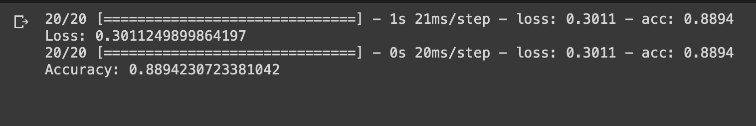
Performance
The accuracy visualized: The model provides an 88.94% accuracy

Slide 9
Scalability
The UI can easily be modified to allow for selection of an alternative deep learning model. This allows for a continuous development of a higher performance model and an allowance for easy integration into the UI.
The program can also be expanded to allow for classification of other medical image types other than chest X-ray scans.

Slide 10
Thank you!

